Slide 1
Python
Functions
By,
M. Karthiga B.E.

Slide 2
What is functions in python?
Named, reusable block of code designed to perform specific tasks.
Input values through parameters.
Process the data – Block of code.
Display the results – Output.
Sends back the result to the place where the function was called – Return.

Slide 3
The syntax…
def function_name(parameters 1, parameters 2):
#block of code
return
a=Function_name(parameters 1, parameters 2)
Print(a)
                def → The mandatory keyword that tells python you are defining an function.
                Function_name→ The name of your function typically written in lowercase with underscore.
                Parameters 1 , parameters 2→ accept the input values(arguments)when the function is called.
                Colon:→ Marks the end of the function header and start of the function body.
                Indentation→ The line of code usually 4 spaces, must be consistently indented.
                Return→ that exits a functions and passes the value back to the caller.
                a=function name(parameters 1, parameters 2)→ calling the function.

Slide 4
Parameters, arguments, Return value…
Parameters & arguments→
def add(a, b):
c=(a+b)
return c
d=(add(10,20))
print(d)
Return value→
What happens if we do not use return?
Where does the return value stored?
how can we retrieve the return value for future operations?

Slide 5
Types of functions
.
FUNCTIONS
Pre-defined
functions
User-
Defined
functions
Already provided by python.
Created by the programmer using def keyword, to perform a specific task.

Slide 6
Build in functions…
Python has 73 built-in functions (in Python 3.15.2 – Oct 25, 2026).
Most important build in functions→
Type conversion | int(), float(), str(), bool()
Mathematical | sum(), max(), min(), pow(), round()
Sequence | len(), range(), sorted(), reversed()
Type checking | Type()
Functional programming | map(), filter()
Input/output | input(), print(), open()

Slide 7
.
Map()
The syntax-
map(function, iterable)
a = [1, 2, 3, 4, 5]
def square(n):
return n * n
result = map(square, a)
print(list(result))
➔output – [1,4,9,16,25]
Filter()
a = [1, 2, 3, 4, 5, 6]
result=filter(lambda x: x % 2 == 0, a)
print(list(result))
→output:
[2,4,6]

Slide 8
User defined functions…
Build by the programmers from scratch to perform the task.
Types→
Without arguments.
With arguments -
Default arguments
Positional arguments
Keyword arguments
Variable length –positional arguments& keyword arguments
Lambda function
Recursion function

Slide 9
User defined -Without arguments
we define the function without parameters inside the parentheses.
Eg:
def check():
n=int (input ("enter a number:"))
if n % 2 == 0:
print("Even number")
else:
print("Odd number")
check()
What if we add print(check()) to this part?

Slide 10
User defined - With arguments…
Default arguments – Parameters have pre defined default values.
def add(a, b=20):
c=a+b
return c
d=add(10)
Print(d)
➔output - 30
Positional arguments-arguments are passed based on the position.
def add(a,b):
c=a+b
return c
d= add(10,20)
Print(d)
➔output - 30

Slide 11
User defined - With arguments…
Keyword arguments – values are passed using parameters names.
def add(a,b):
c=a+b
return c
d=add(a=10, b=20)
Print(d)
➔output – 30
What if?
d=add(b=20,10)
Print(d)
➔output - ???
Variable length-**kwargs
def add(**args):
t=0
for i in args.value:
T=t+1
return T
d=add(a=10, b=20)
Print(d)
➔output – 30
What if?
d=add(10,20)
Print(d)
➔output - ???

Slide 12
Variable length-positional arguments
def add(*z):
t=0
for i in z:
T=t+i
return(T)
a=add(10,20,30)
print(a)
➔output: 60
*Asterisk symbol says python to collect multiple positional arguments into a tuple.
Z is a variable, the traditional variable name is args.
*args
**kwargs – Collects arguments into a dictionary, it stores in keys and values.

Slide 13
Lambda function…
a = [1, 2, 3, 4, 5, 6]
result=filter(lambda x: x % 2 == 0, a)
print(list(result))
→output: [2,4,6]
What happens here?
filter() → Selects elements based on a condition.
lambda x → Takes each element from the list as input.
x % 2 == 0 →condition check.

Slide 14
Recursion function
It calls itself repeatedly to solve a problem, breaking it into smaller sub problems, until a specific terminating condition (base condition) is reached.
The syntax:
def function_name():
if condition: # Base condition
return
function_name() # Recursive call
function_name()

Slide 15
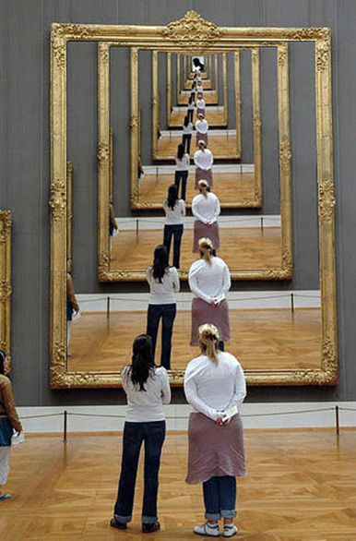
def display(n):
if n == 6:
return
print(n)
display(n + 1)
display(1)
➔output – 1
2
3
4
5

Slide 16
FAQs
What is a function in Python?
What is the syntax of a function?
What is the purpose of the def keyword?
How do you call a function?
What are the advantages of using functions?
What happens if we define a function but do not call it?
Can a function call another function?
What are the types of functions in Python?

Slide 17
What are the four types of user-defined functions based on arguments and return values?
What are parameters & arguments in Python?
What are the different types of arguments in Python?
What is the return statement in Python?
What is the difference between print() and return?
What happens if we do not use a return statement?
Can a function return multiple values?
What is a lambda function?
Function scope (local and global variables).

Slide 18
Add two numbers using a function
Check even or odd
Find factorial of a number
Check palindrome
Find maximum of three.
Reverse a string
Find a sum of numbers using *args.
Calculate square using lambda
Find Fibonacci series
Find even numbers using filter()

Slide 19
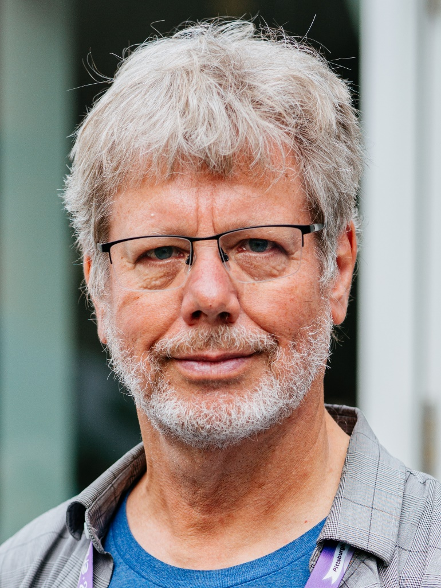
Thank You!

